Slide 1



NTI
FPGA
UART (TX&RX)
Presented by Mohamed Zanaty

Slide 2
UART:
UART (Universal Asynchronous Receiver/Transmitter) is a serial communication protocol used to transfer data between digital systems without requiring a shared clock.
In this project, a complete UART Transmitter (TX) and Receiver (RX) system was designed using Verilog HDL. The TX converts parallel input data into a serial UART frame, while the RX receives the serial frame and converts it back into parallel data.
The Transmitter (TX) consists of an FSM controller, parallel-to-serial serializer, parity-bit generator, and MUX to control the transmission sequence.
The Receiver (RX) uses an FSM controller, serial-to-parallel shift register, data sampling logic, and parity/frame error detection to correctly recover the transmitted data.
The UART frame is transmitted and received in the following order:
Start Bit → Data Bits → Optional Parity Bit → Stop Bit
The design is parameterized, allowing the data width to be changed easily. It also supports even/odd parity selection, TX busy status, transmission completion detection, RX data-valid indication, and parity/frame error detection.

Slide 3
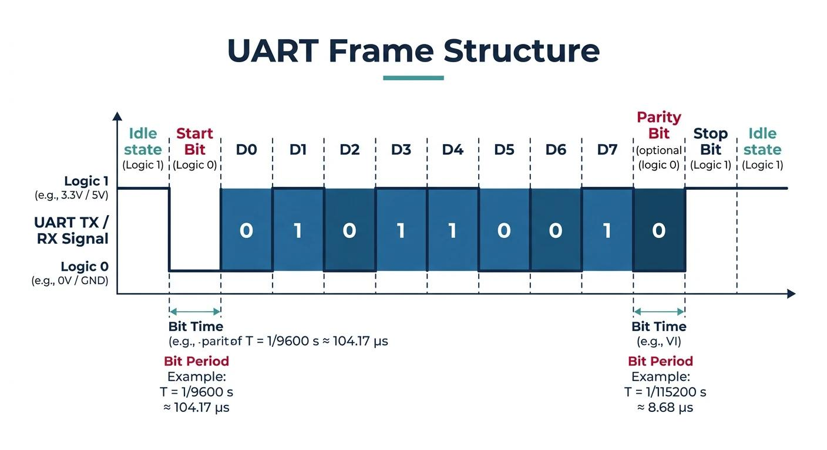
FRAME FORMAT

Slide 4

what i made ?
TX:
i divied the project into 4 modules:
FSM
SERIALIZER
PARITY_CALC
MUX
RX:
i divied the project into 3 modules:
FSM
DESERIALIZER
PARITY_CHECK

Slide 5
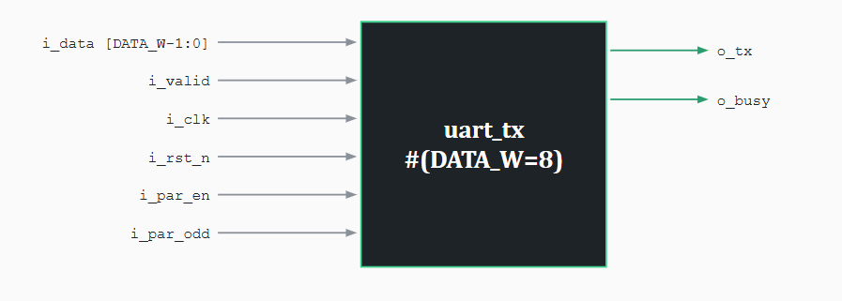
UART_TX:

Slide 6
UART_TX:
FSM:
i choose 5 states for controlles:
START: that is the start to system and generate first bit (0) and make the system busy.
DATA: make mux get data from the serializer stage.
PARITY: make mux get data from parity if P_en = (1).
STOP: that is stop and idle stage make the mux out (1).
IDLE : for non input make the out = (1).
SERILAZIER:
for serializer i made parallel to serial converter
it get data when load is (1)
and start when (1)
that is make a delay, if a new data come the serial will a delay and start but i think it is okey because get a space for a start_bit (0).

Slide 7
UART_TX:
PARITY_CLAC:
this stage calculate the parity:
if even the system xor the input data.
if odd the system xnor the input data.
MUX:
Just a mux has 4 different staes and controlles the output:
S0: out a start_bit (0).
S1: out the serial data.
S2: out the parity_bit.
S3:out the end_bit (0).

Slide 8

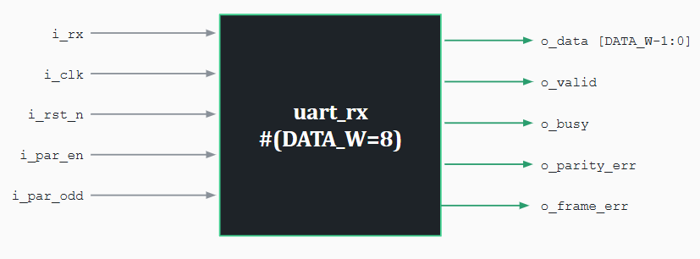
UART_RX:

Slide 9
UART_RX:
FSM:
i choose 4 states for controlles:
IDLE: that detects first bit of frame by neg_edge detector.
DATA: deserlize the data.
PARITY: check parity when it is.
STOP: end of frame and out valid and back to idle.
DESERILAZIER:
it group the data and out done for fsm make it move to next state.
PARITY_CHECK:
check the data and parity bit to sure if there is an error or not (o_parity_err).

Slide 10
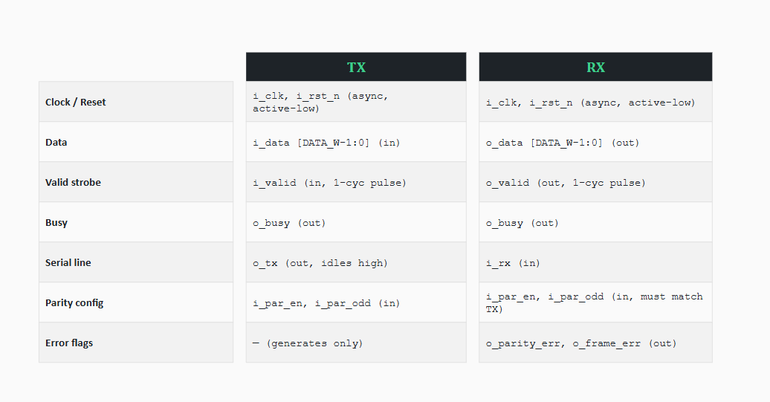
FOR test bench:

Slide 11
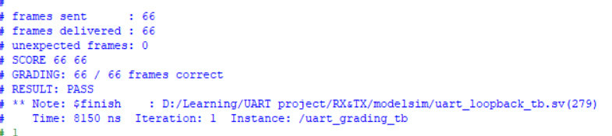
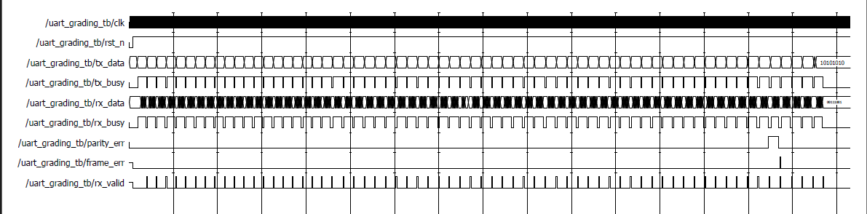
TEST BENCH:
i achived all tested 66\66.

Slide 12

THANK YOU

